Slide 1

Data Science Capstone Project
Joanna Burska

Slide 2


Agenda
Executive Summary
Introduction
Methodology
Results
Conclusion

Slide 3

Executive summary
The aim of this presentation is to determine what kind of factors contribute to successful landing of SpaceX Falcon 9 rockets.

Slide 4
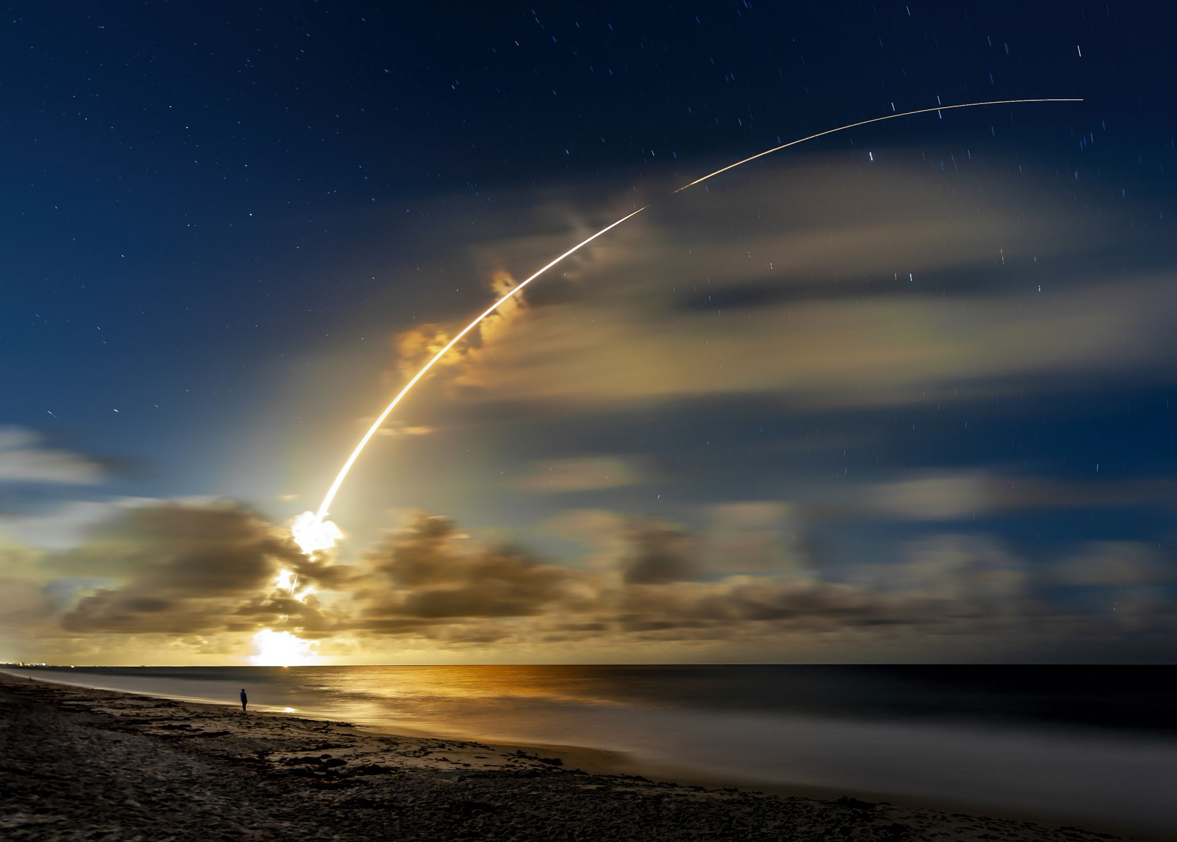
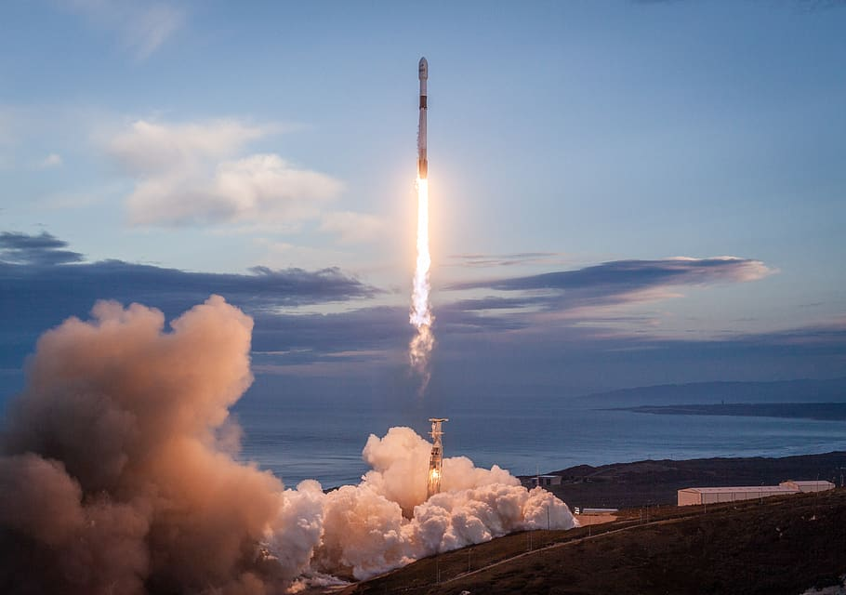
Introduction
SpaceX advertises Falcon 9 rocket launches on its website with a cost of 62 million dollars
Based on previous successful and unsuccessful rocket landing I will try to predict successful landing of the rocket

Slide 5
Methodology
Data collection
Data wrangling
API
Web scrapping
Performing EDA with visualisation and SQL and interactive visualisations
Using various machine learning models to determine most accurate predictions

Slide 6
Data collection
There we two methods used to collect data: API and Webscrapping
API
API-sending response request to Specex API website json file were retrieved which included rocket, launchpad, and payload data, there data were appended to the list and data frame created.
Subset of data frame was created by keeping only specified columns: rocket, payloads, launchpad, cores, flight number and date_utc. Multiple cores were removed, lists in payload and cores were replace by single value, and date_utc was converted to datetime and restricted to only date after 13/11/2020.Dataframe was only restricted to Falcon 9 launches.

Slide 7
Data collection
Webcrapping
Data was retrieved by using BeautifulSoup
Date, booster_version, landing_status, get_mass, were defined.
Request to Wikipedia URL was made using BeautifulSoup and object was created from HTML response.
Third table from Wikipedia page was retrieved with following columns: Flight No., Launch site, Payload, Payload Mass, Orbit, Customer, Launch outcome, Version Booster, Booster landing, Date, Time

Slide 8
EDA and interactive visualisation
Reading SpaceX dataset into a Pandas data frame
Creating visualisations encoding data from machine learning models:
Payload Mass vs flight Number
Launch Site vs Flight Number
Launch Site vs Payload Mass
Success Rate vs Orbit Type
Orbit vs Flight number
Orbit vs Payload Mass
Success Rate vs year

Slide 9
Interactive visualisations
Importing urllib request
Getting url with spaces_lauch_dash.csv and downloading file
Creating data frame
Importing Dash
Adding launch site drop down input
Add a callback function to render pie chart on selected dropdown
Add a Range Slider to Select Payload
Add a callback function to render the scatter plot

Slide 10
Predictive ANALYSIS
Loading data frame
Define dependet and independent variables
Create NumPy array from class data (Y-Dependent variable)
Standardise data
Split data to test and train sets
Creating logistic regression, KNN, SVM and Decision Tree Models with confusion matrix and accuracy score
Comparing Jaccord_Score, F1_Score and Accuracy score for all 4 models

Slide 11
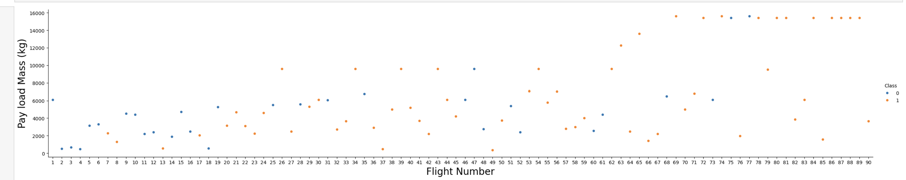
EDA with visualisation
Graph shows relationship between payload mass and Flight number.
The higher flight number the more probability of successful landing.
Also, higher Pay Load Mass more chance of successful landing

Slide 12

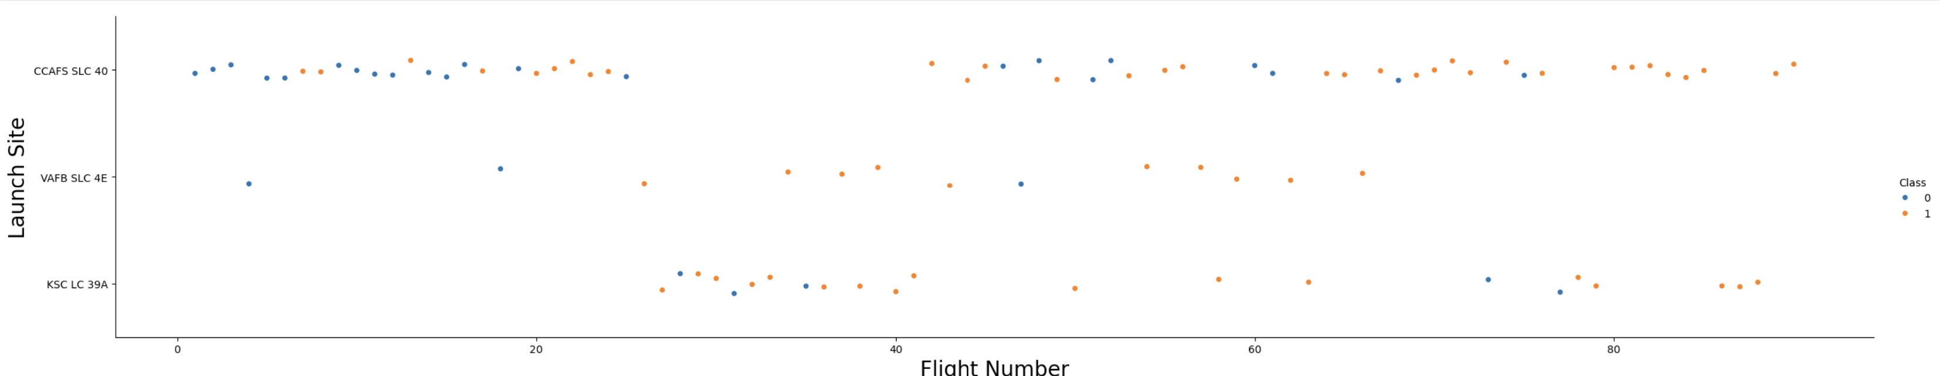
EDA with visualisation
Graph below shows relationship between Launch Site mass and Flight number.
Site CCAFS SLC 40 has the highest number of flights however most successful site was VAFB SLC 4F.

Slide 13
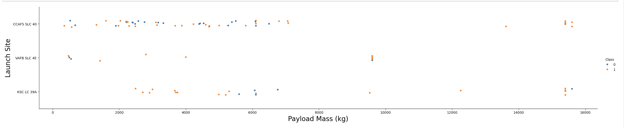
EDA with visualisation
Graph below shows relationship between Launch Site mass and Payload Mass.
If Payload Mass is over 9000 kg change of success increases to almost 100%

Slide 14
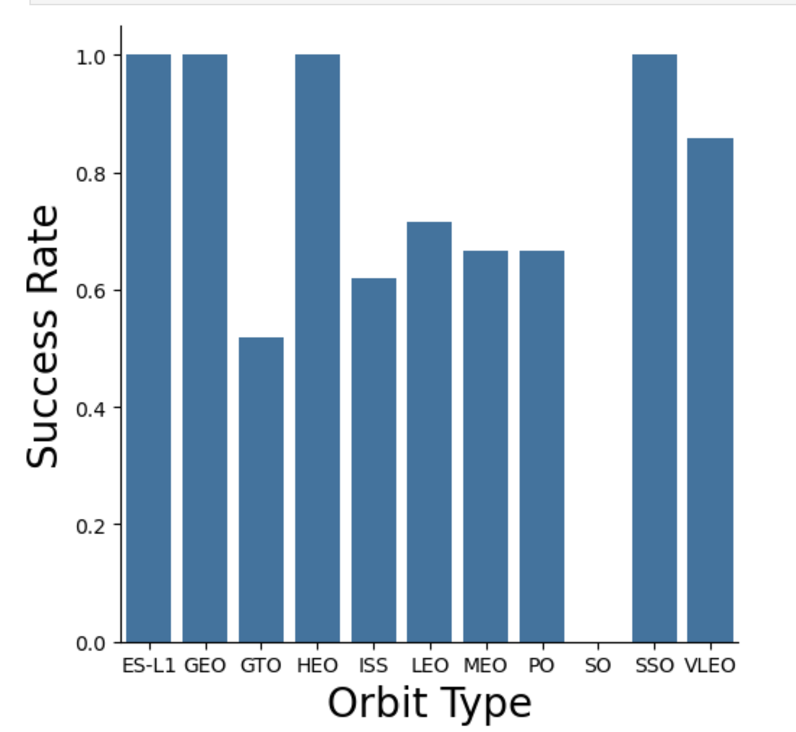
EDA with visualisation
Graph shows relationship between Success Rate and Orbit Type
There are 4 of them (ES-L1,GEO,HEO.SSO) with 100% success rate
Maybe it’s wort to investing what distinguished these Orbits fro the other ones?

Slide 15
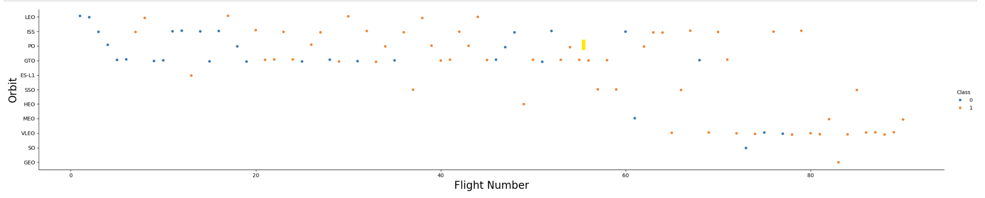
EDA with visualisation
Graph below shows relationship between Orbit and Flight Number.
It look like there is positive correlation between LEO orbit and number of flights whereas the is no relating ship incase of GTO orbit

Slide 16
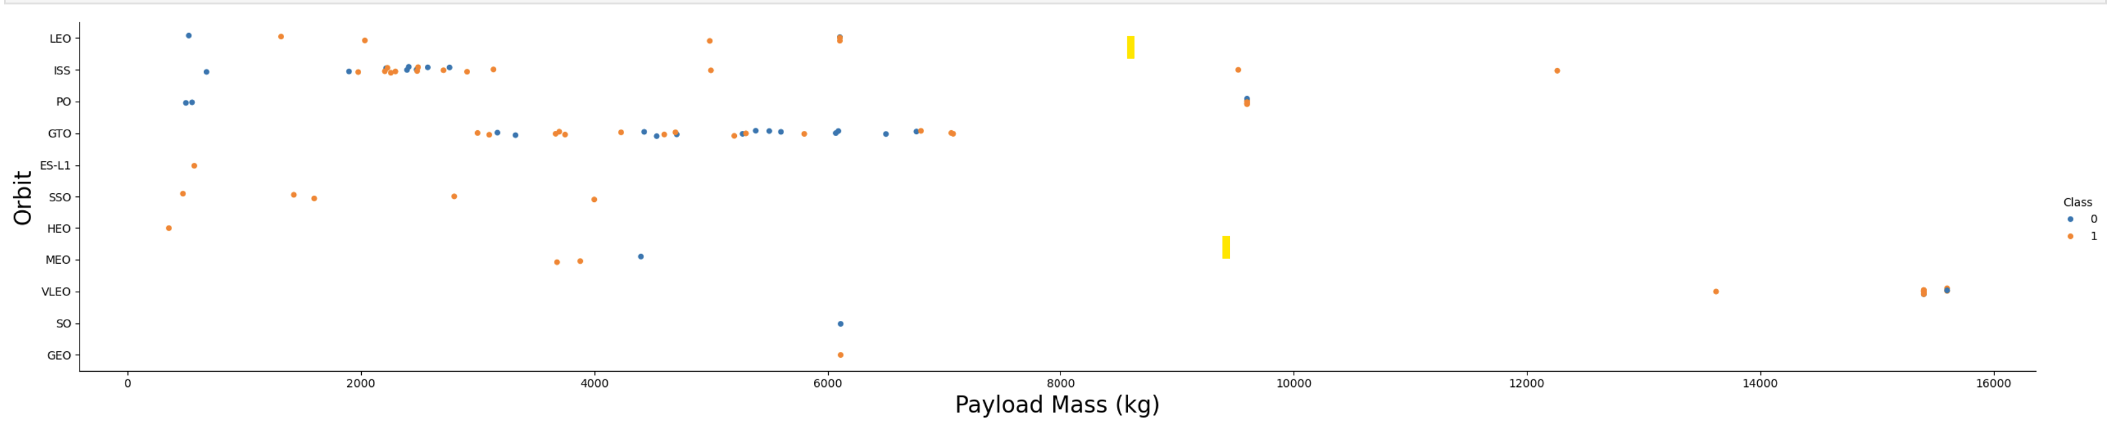
EDA with visualisation
Graph below shows relationship between Orbit and Payload Mass.
There is relationship between heavy payload and Polar, LEO and ISS, however there is no relationship for GTO orbit.

Slide 17
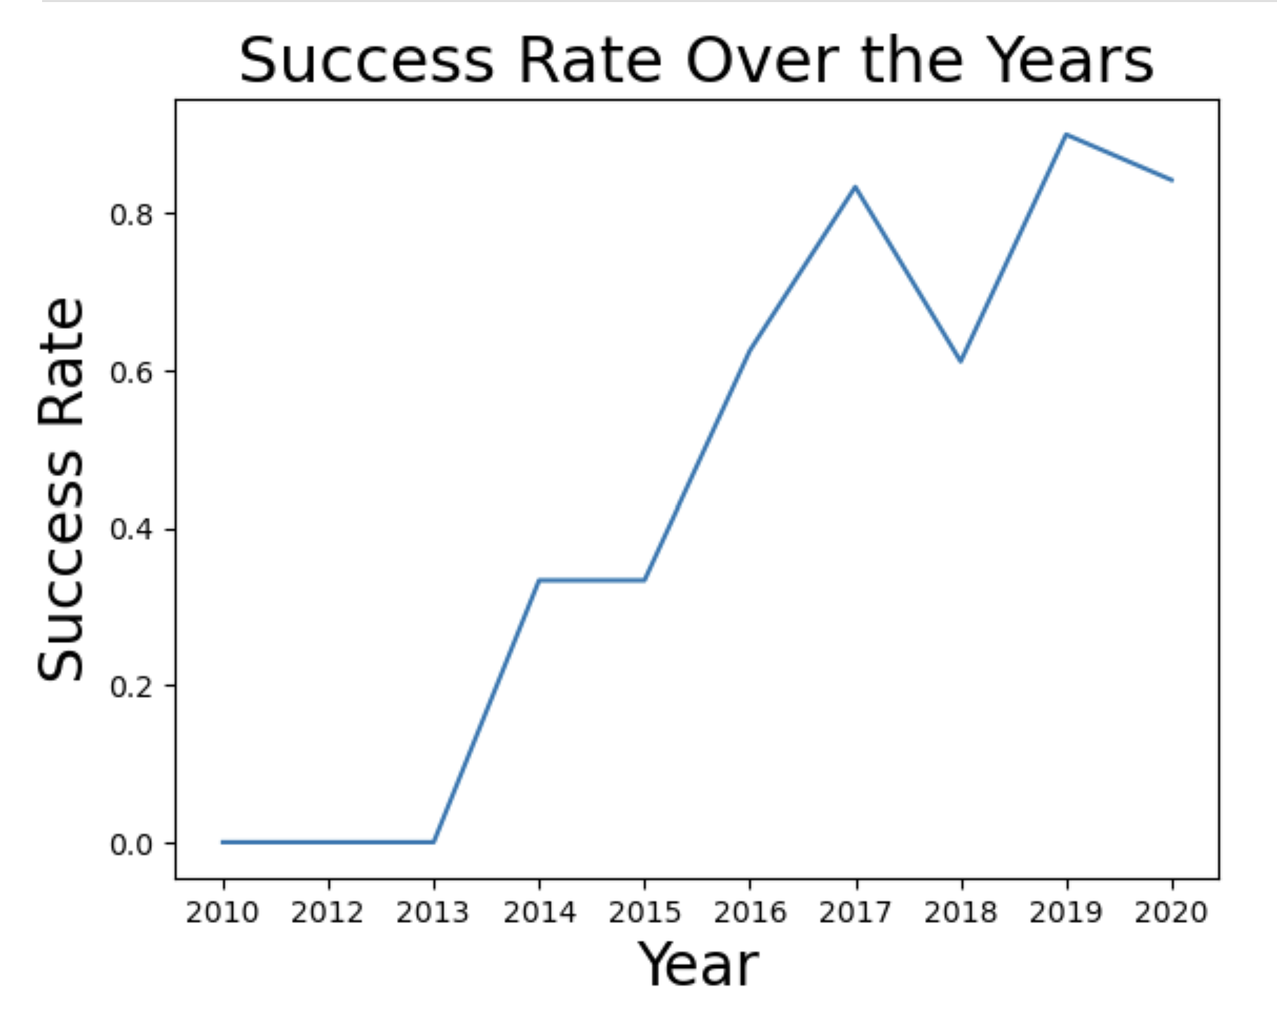
EDA with visualisation
Graph shows relationship between Success Rate and Year
Success rate was steadley increasing until 2017 there was sudden drop in 2018 and increase in 2019. In 2020 we can see sligh drop as compared to 2019.

Slide 18
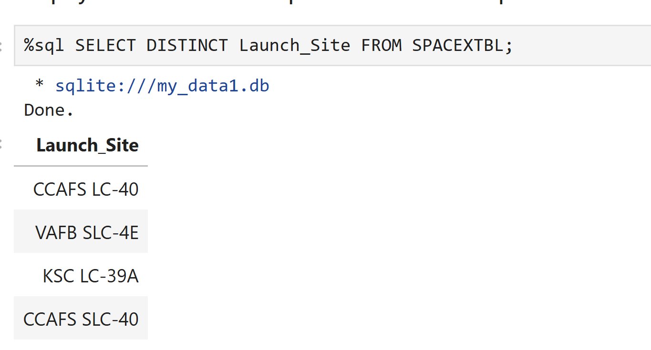
EDA with sql
Unique Launch Sites

Slide 19
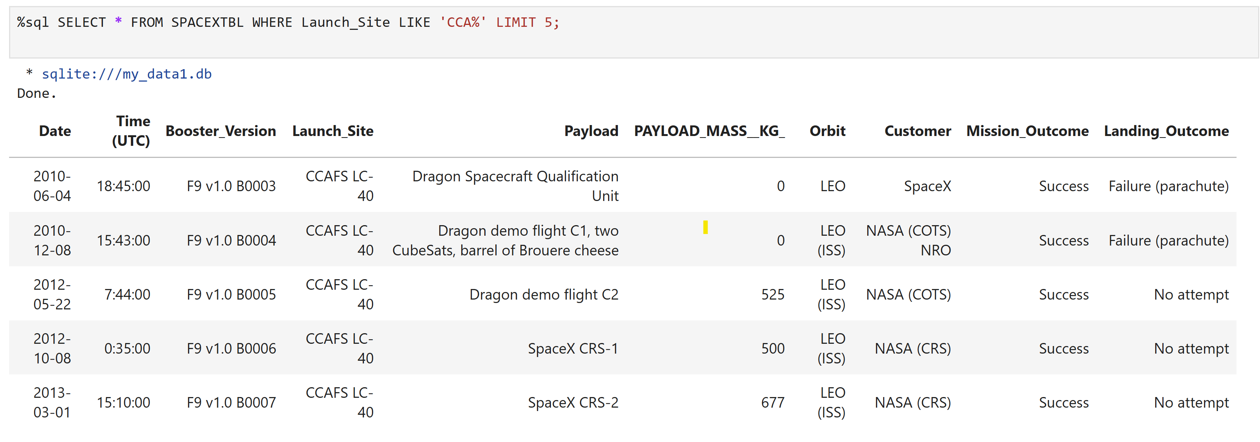
EDA with sql
Unique 5 records where launch sites begin with the string 'CCA

Slide 20
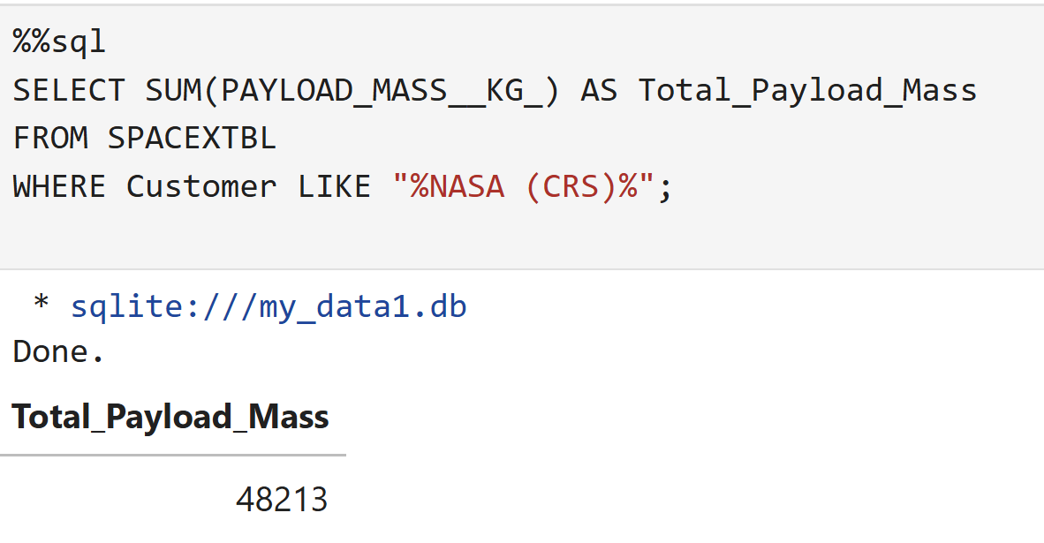
EDA with sql
Total payload mass carried by boosters launched by NASA (CRS)

Slide 21
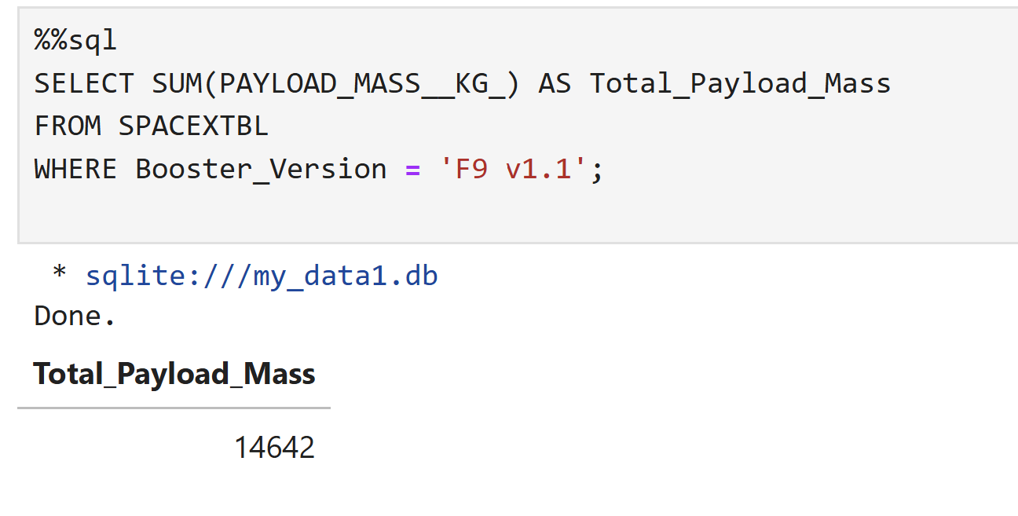
EDA with sql
Average payload mass carried by booster version F9 v1.1

Slide 22
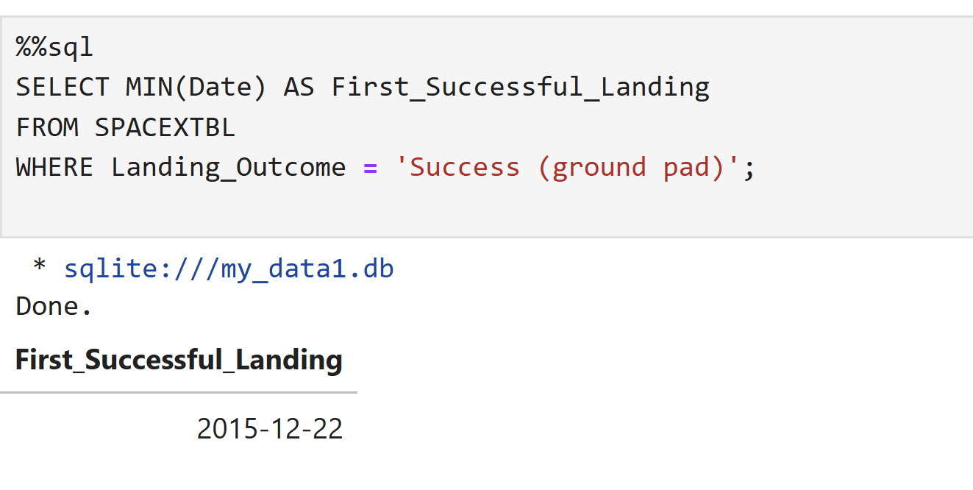
EDA with sql
Date of first successful landing

Slide 23
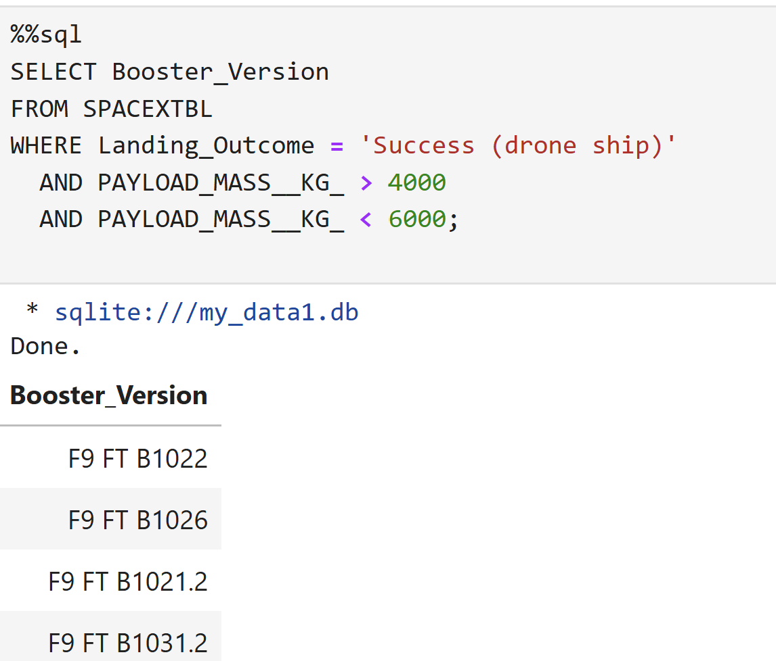
EDA with sql
Boosters which have success in drone ship and have payload mass greater than 4000 but less than 6000

Slide 24
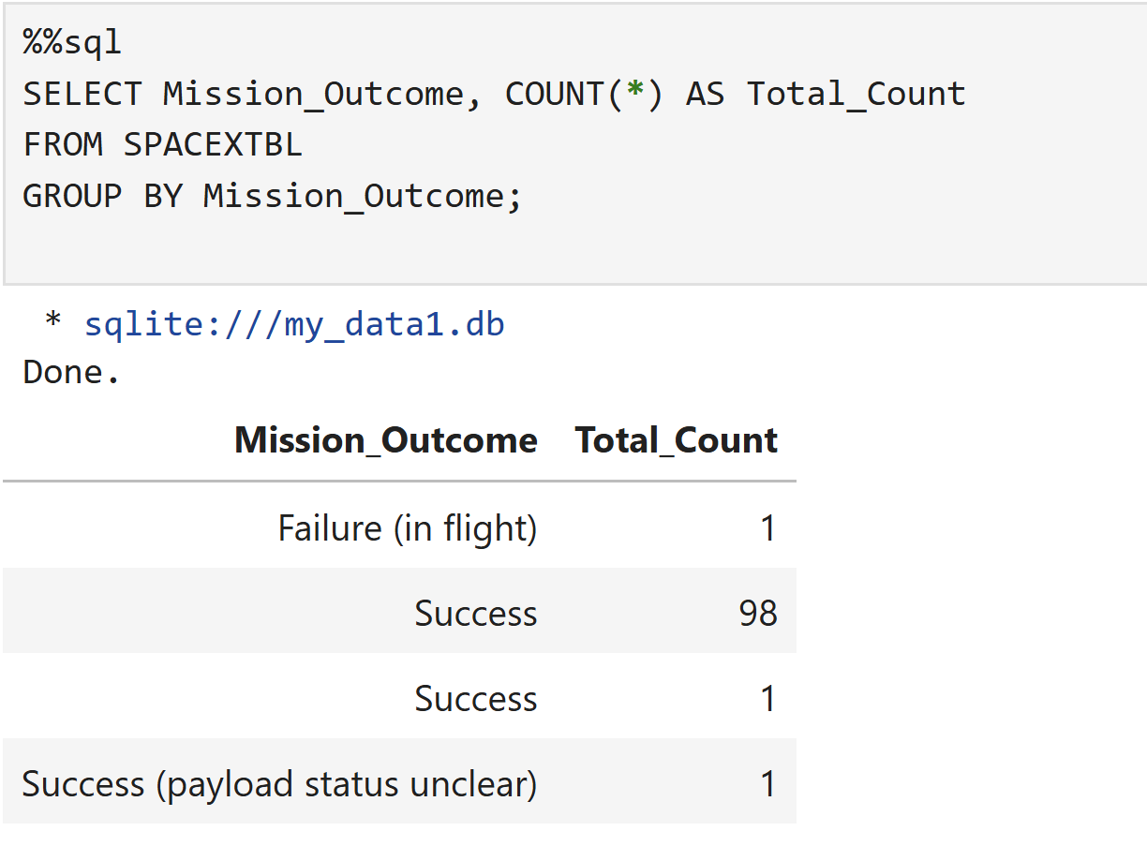
EDA with sql
The total number of successful and failure mission outcomes

Slide 25
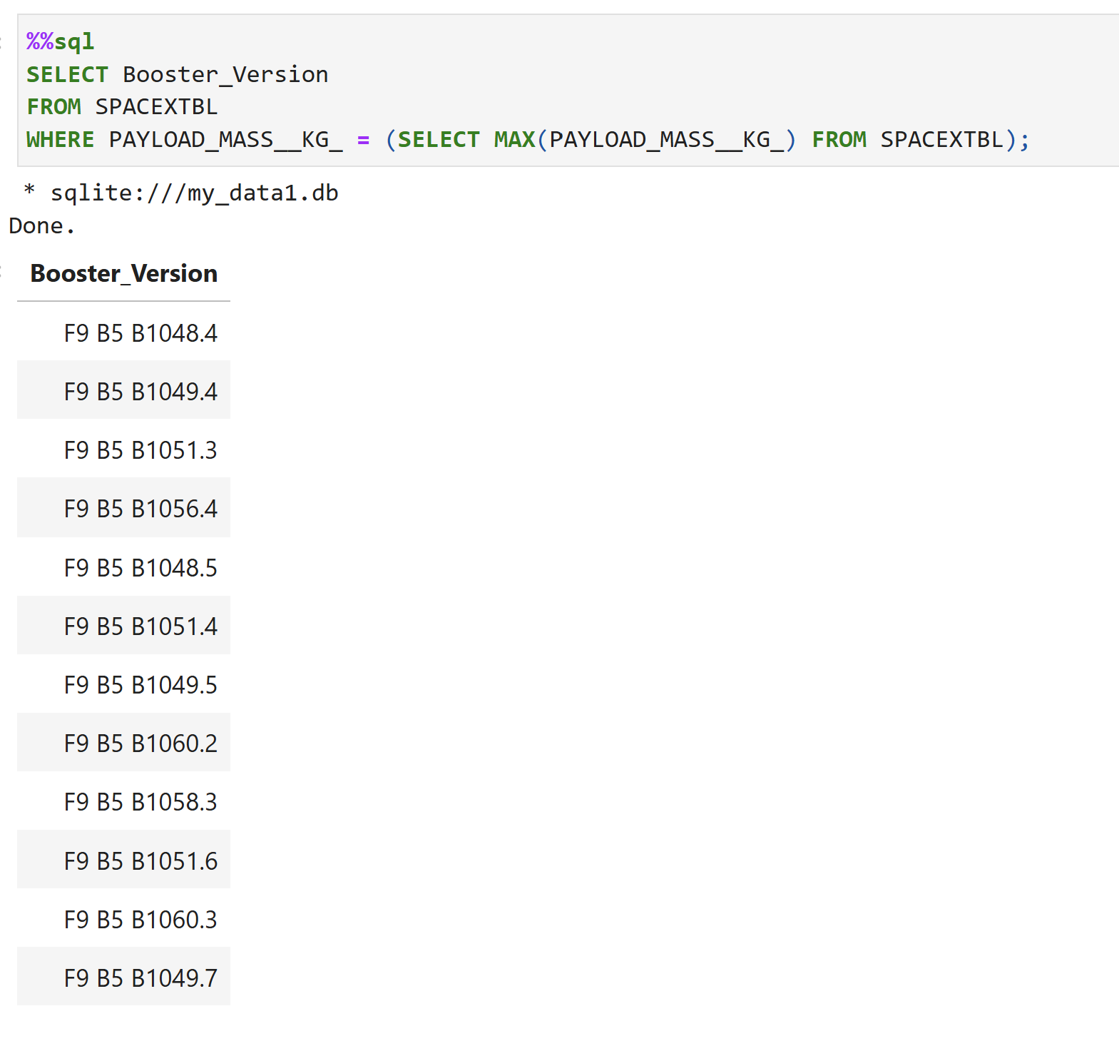
EDA with sql
Booster_versions which have carried the maximum payload mass

Slide 26
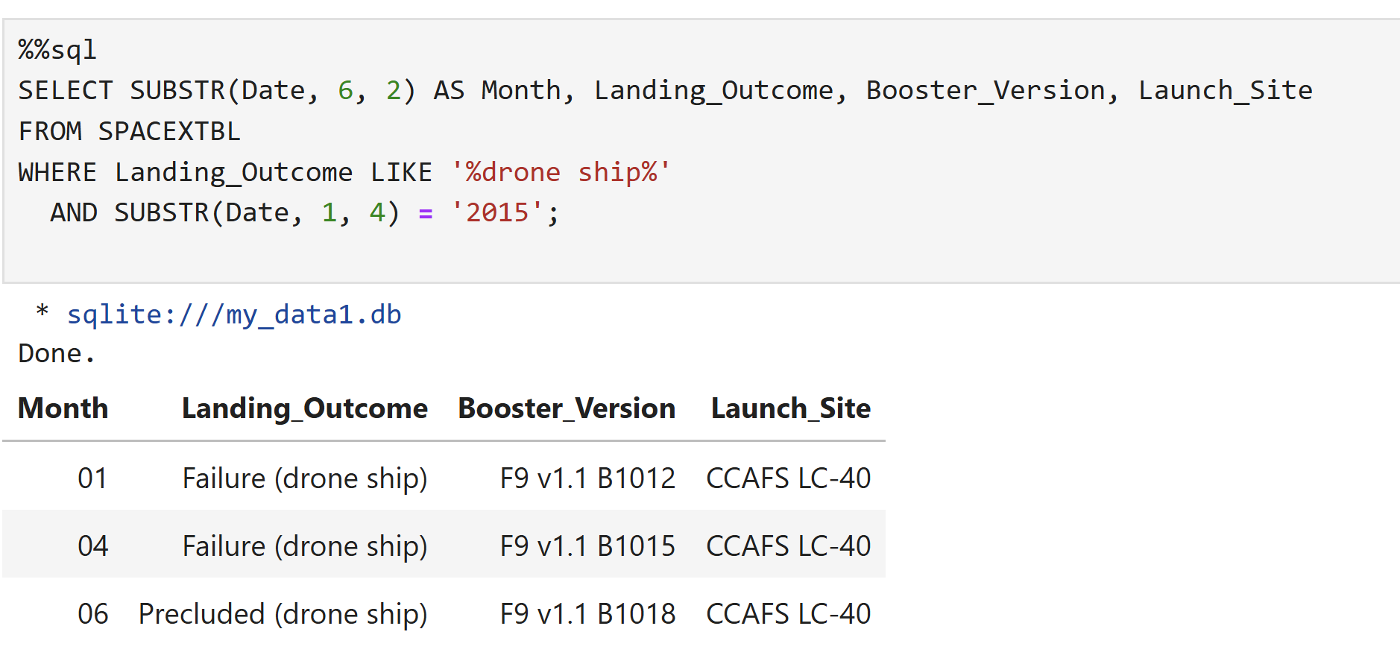
EDA with sql
Failure landing_outcomes in drone ship ,booster versions, launch_site for the months in year 2015

Slide 27
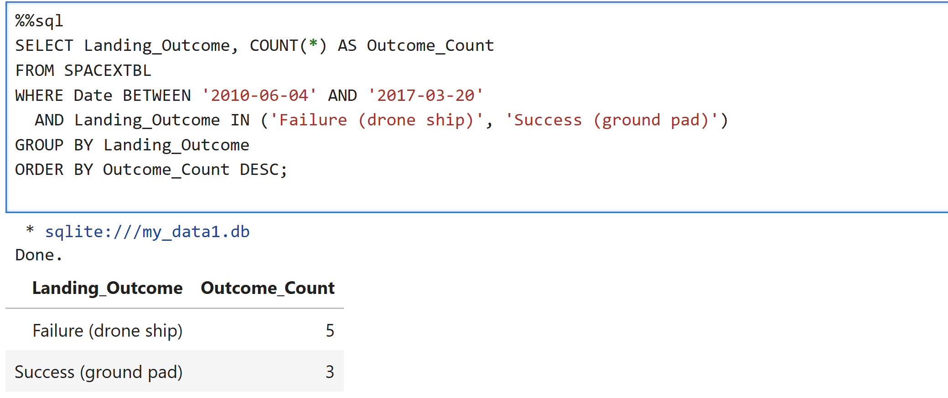
EDA with sql
Landing outcomes between the date 2010-06-04 and 2017-03-20, in descending order.

Slide 28
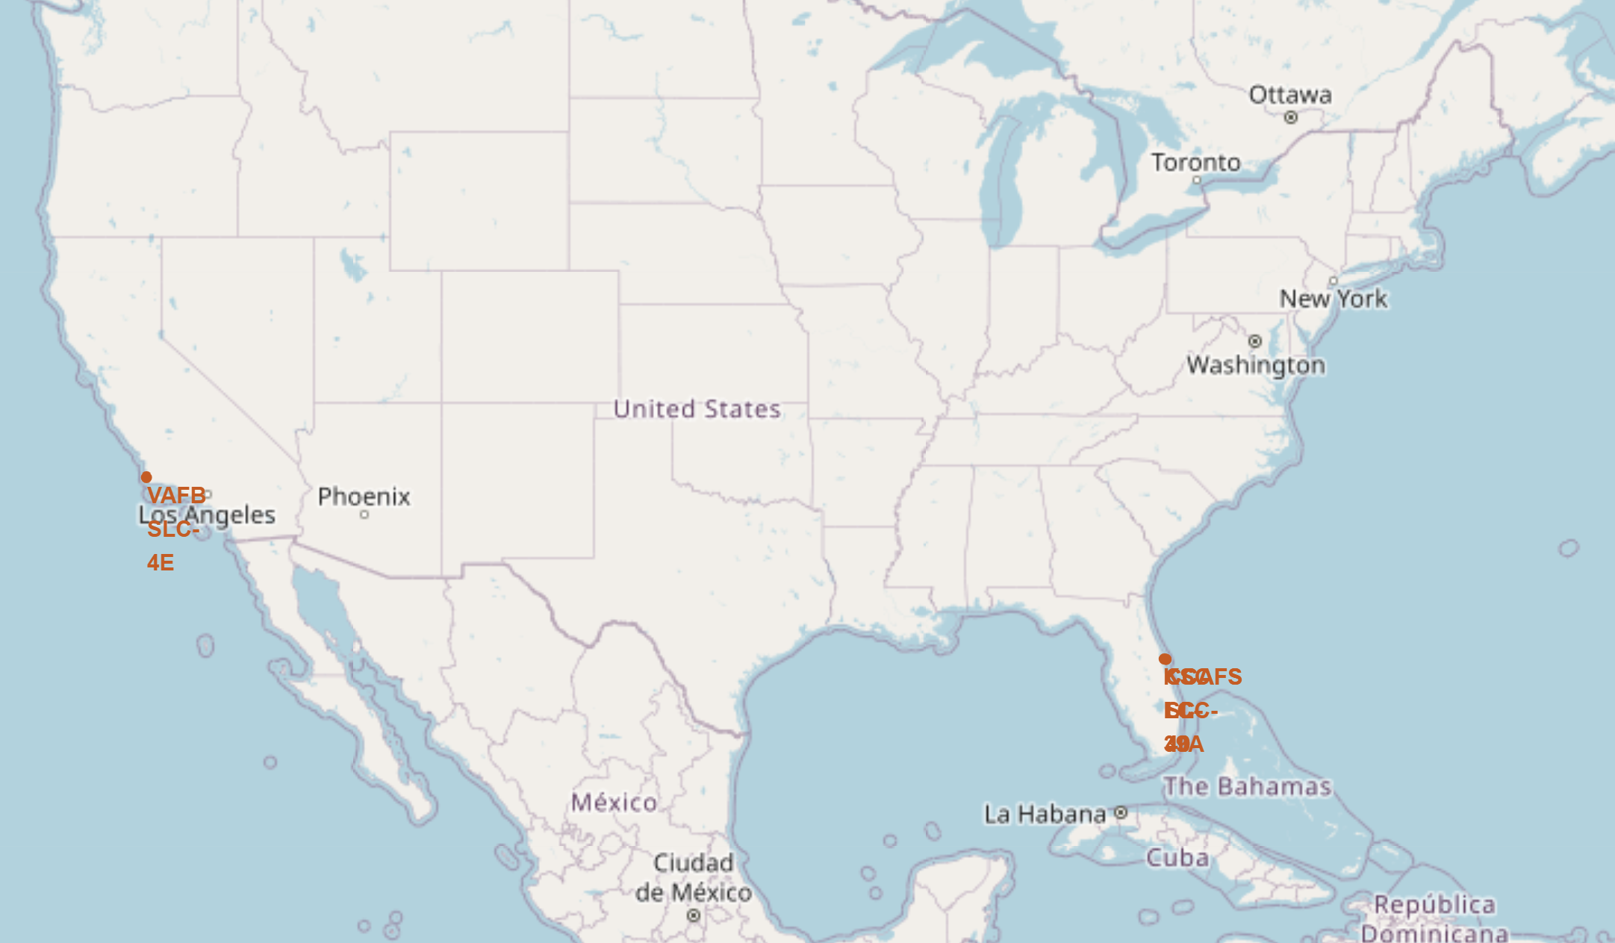
interactive map with Folium
Launch sites locations
Most of the launch sites in this project are located near the equator.
Additionally, these launch sites are situated close to the coast.
This minimizes the risk of debris or failures causing harm to populated areas, as rockets are typically launched over the ocean to ensure safety.

Slide 29
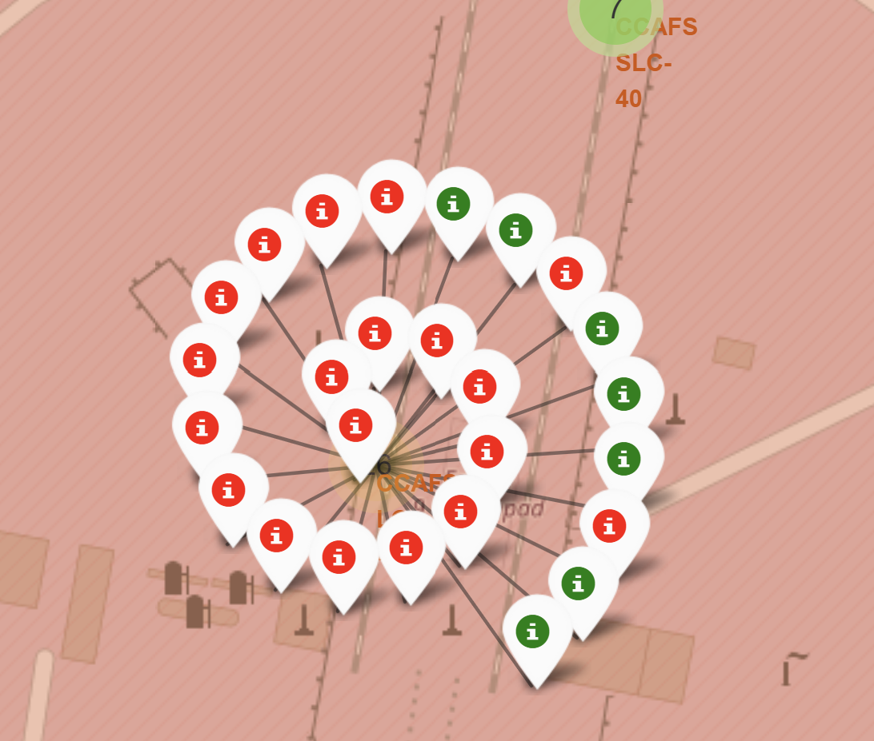
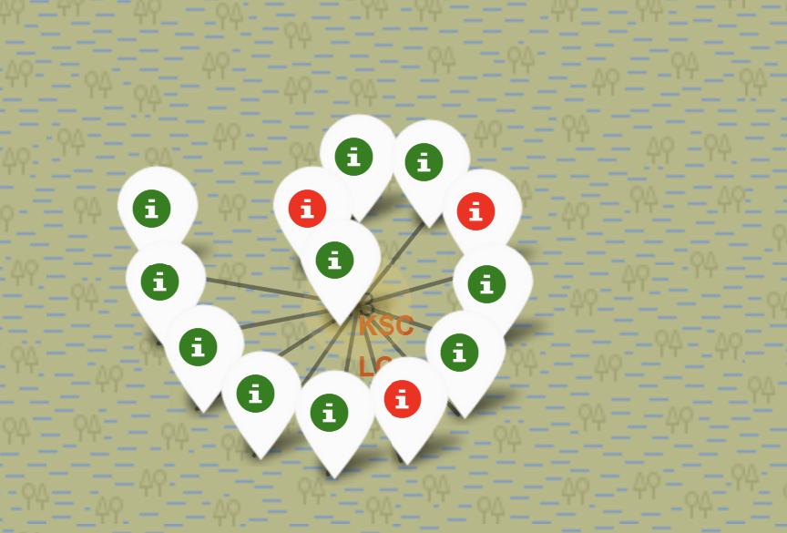
interactive map with Folium
Launch sites locations success and failed launch
From the color-labeled markers in marker clusters, its easy to identify which launch sites have relatively high success rates.

Slide 30
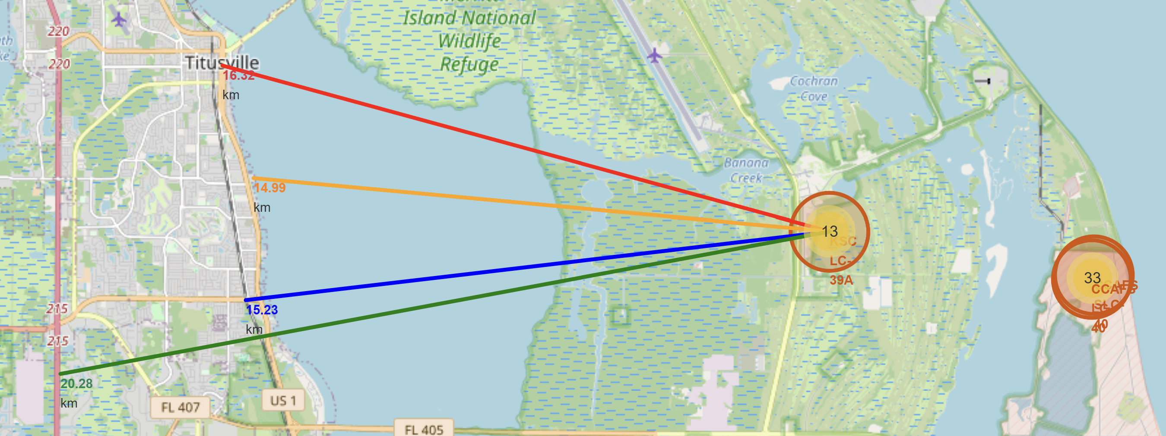
interactive map with Folium
Launch sites locations proximity to railway highway and coastline.
From the visual analysis of the launch site KSC LC-39A we can clearly see that it is:
relative close to railway (15.23 km)
relative close to highway (20.28 km)
relative close to coastline (14.99 km)

Slide 31
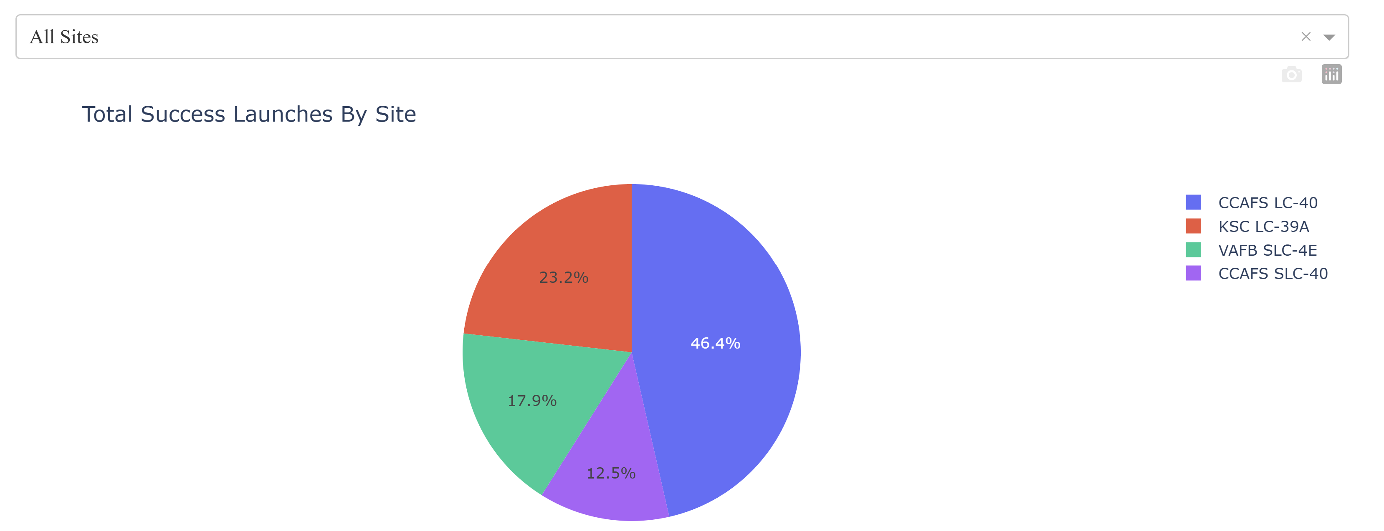
Plotly dASHBOAD
Graph presents success rate of of all sites

Slide 32
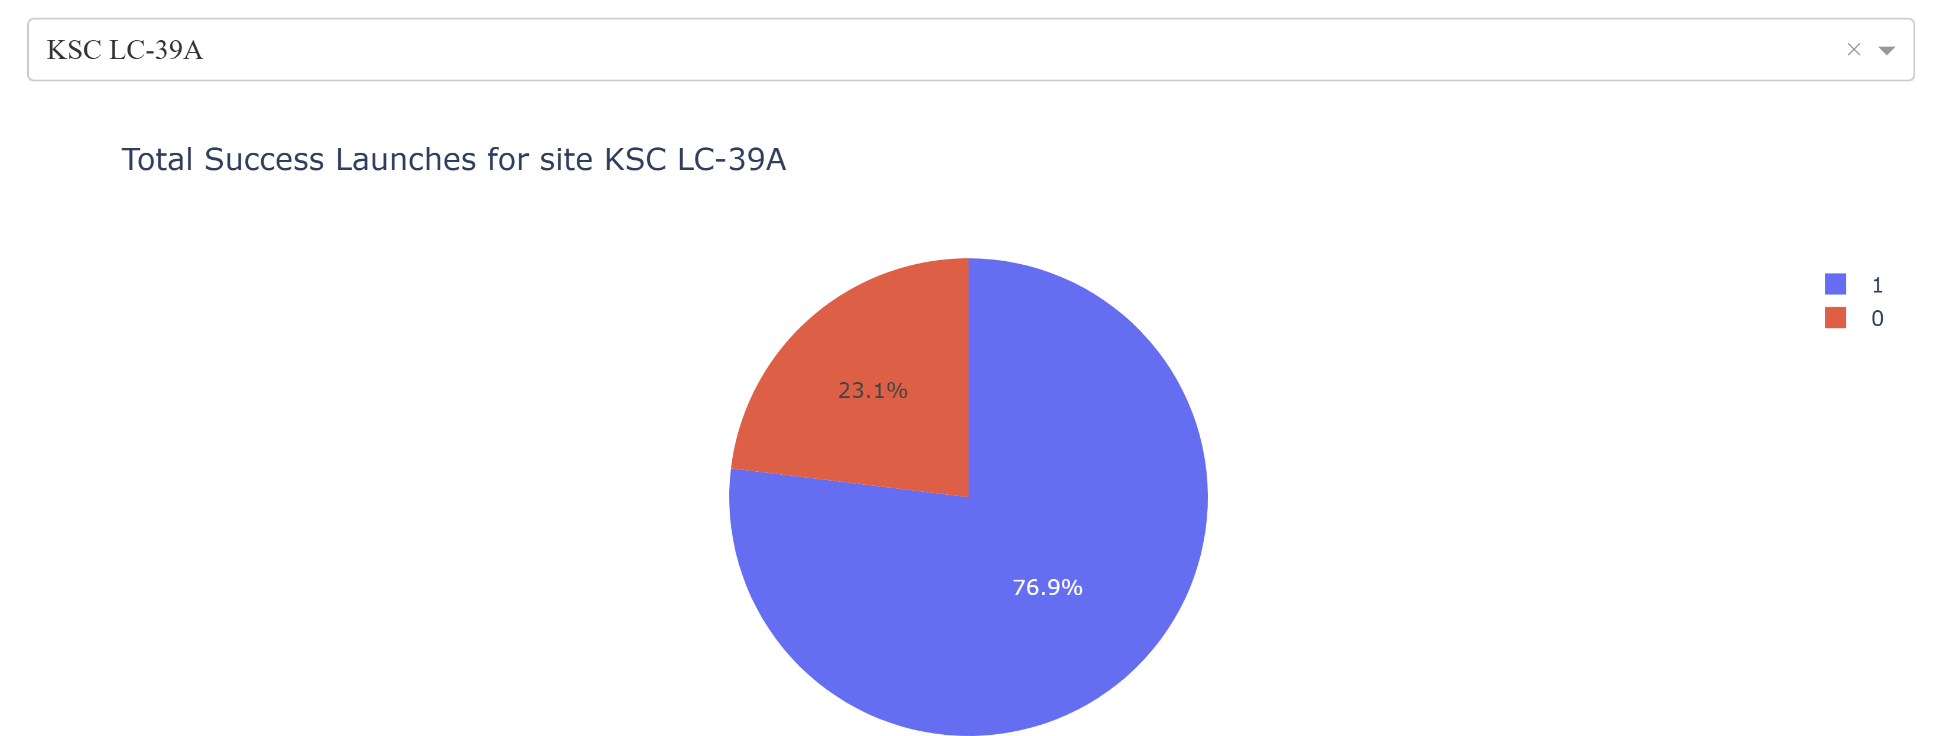
Plotly dASHBOAD
Graph presents success launches for site KSC LC-39A

Slide 33
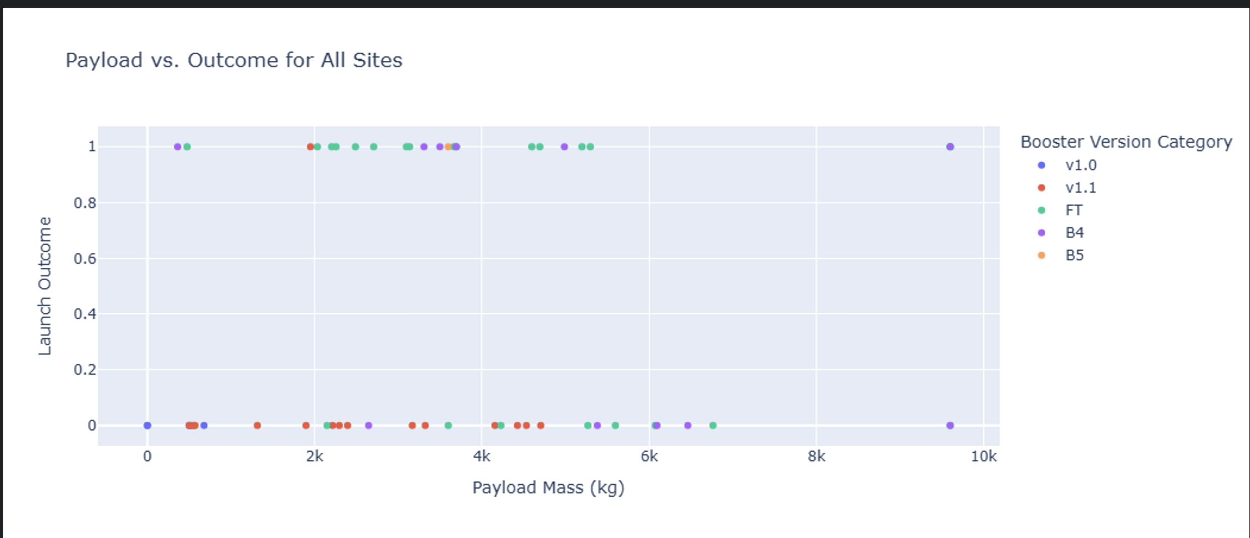
Plotly dASHBOAD
Graph presents Payload vs Outcome for all sites by booster version

Slide 34
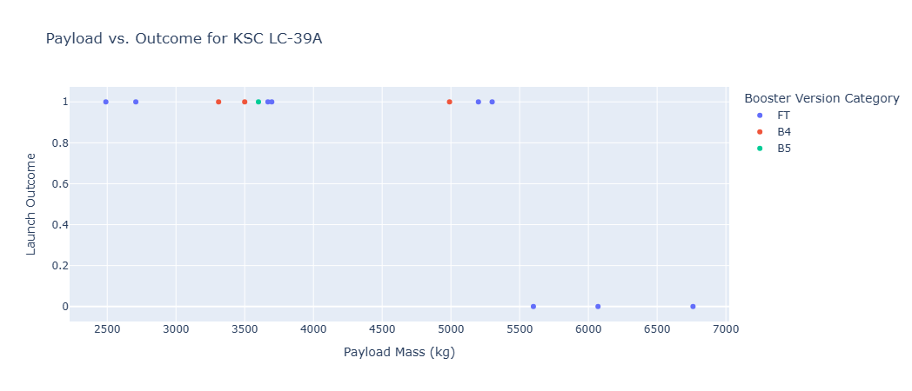
Plotly dASHBOAD
Graph presents Payload vs Outcome for KSC LC-39A

Slide 35
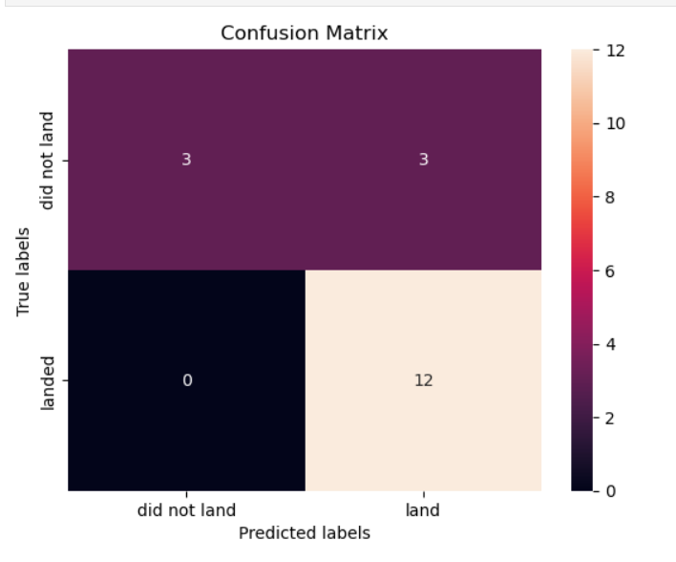
Predictive Analysis confusion matrix
There were 4 machine models used to find out how well each of the can predict successful and unsuccessful landing. Models used were logistics regression, SVM,KNN, decision trees.
All models produced similar confusion matrix. They classified correctly 3 unsuccessful landings and 12 successful landing, however 3 ladings classified by models as successful were unsuccessful.

Slide 36
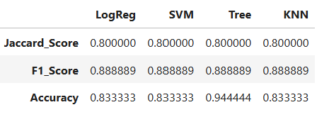
Predictive Analysis accuracy scores
Accuracy score on test set are almost identical. The is only one significantly different value in decision tree model.
There is not possible to distinguish which model perform the pest on test data set.

Slide 37
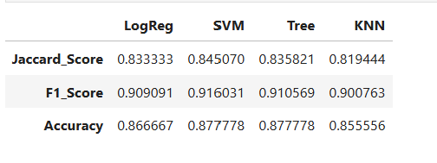
Predictive Analysis accuracy scores
Accuracy score on whole data set differ by the models, but the values are very closed therefore it difficult to distuingush which model performs the best

Slide 38
CONCLUSION
Successful landing can be corelated to Payload Mass when mass reaches over 8000 kg success rate is almost 100%.
Orbits with 100% success rate are ES-L1,GEO,HEO and SSO.
Between 2014-2020 succes rate has increased from 30% to 80%
Sites are in close proximity to the cost, railway and highway.
Thes site with the highest % of successful launches is KSC-39A (76.9%).

